Slide 1
Mass Measurements
Lecture 1 – October 7, 2015
D. Lascar | Postdoctoral Fellow | TRIUMF

Slide 2
Outline
Different kinds of masses
Precision
Precision v. accuracy
Precision required
Why measure masses?
How can we measure masses?

Slide 3
Precision v. Accuracy
x
x
x
x
x
x
x
x
x
x
x
x
x
x
x
x
x
x
x
x
x
x
x
x
x
x
x
x
x
x
Not Accurate
Not Precise
Accurate
Not Precise
x
x
x
x
x
x
x
x
x
x
x
x
x
x
x
x
x
x
x
Not Accurate
Precise
Accurate
Precise

Slide 4
Mass
The property of a body to attract another body via gravitation
Gravitational mass
Object’s resistance to changing acceleration
Inertial mass
The sum of all the rest energy in a body
Mass-energy relation
$$F=\frac{Gm_{1}m_{2}}{r^{2}}$$
$$\vec{F}=m\vec{a}$$
$$m=\left(\begin{aligned}Nm_{n}+Z{(m}_{p}+m_{e})− \\ −\frac{1}{c^{2}}\sum_{i}{BE_{i}}\end{aligned}\right)$$
Notes:
The binding energies are all the binding energies of the nucleus and the atom
Note the change in the last equation
After slide
Play gravitation video

Slide 5
Why measure masses?
$${}_{}^{17}{\text{Cl}}$$
Chlorine
35.453
Molar mass
35.453 ± 0.002 g/mol 35.453(2) g/mol
$\frac{δm}{m}=\frac{0.002}{35.453}≈6×{10}^{−5}$
$N_{A}=6.022140857\left(74\right)×{10}^{23}$ particles/mol
$\frac{δm}{m}=\frac{0.000000074}{6.022140857}≈1.2×{10}^{−8}$
If you measure out 35.453 g precisely
6.02214(34) x 10²³ atoms
Does it matter?
Depends on the application
Notes:
Molar mass uncertainty is all that matters

Slide 6
Why measure masses?
Particle/molecular identification
What is the difference between:
¹⁸⁰Hf
¹⁷⁹HfH
C₆H₁₂O₆ – Glucose
C₉H₈O₄ – Caffeic Acid (Aspirin)
C₁₀H₁₂O₃ - Tyrosol, acetate
C₇H₇F₃O₂ – No idea but it exists in nature

Slide 7
Why measure masses?
 | Mass (AMU) | m - M(¹⁸⁰Hf) (AMU) | $$\frac{Δm}{M}$$
¹⁸⁰Hf | 179.9466 | -- | --
¹⁷⁹HfH | 179.9538 | 0.0071 | 3.94 x 10⁻⁵
C₆H₁₂O₆ | 180.0648 | 0.1168 | 6.49 x 10⁻⁴
C₉H₈O₄ | 180.0432 | 0.0957 | 5.32 x 10⁻⁴
C₁₀H₁₂O₃ | 180.0800 | 0.1321 | 7.34 x 10⁻⁴
C₇H₇F₃O₂ | 180.0406 | 0.0933 | 5.18 x 10⁻⁴

Slide 8
Atomic and nuclear masses
Slide courtesy of K. Blaum TRIUMF Summer Institute

Slide 9
Most of physics requires masses
General physics and chemistry
Nuclear structure physics
Astrophysics
Weak interaction studies
Fundamental neutrino physics
Fundamental symmetries
Tests of QED

Slide 10
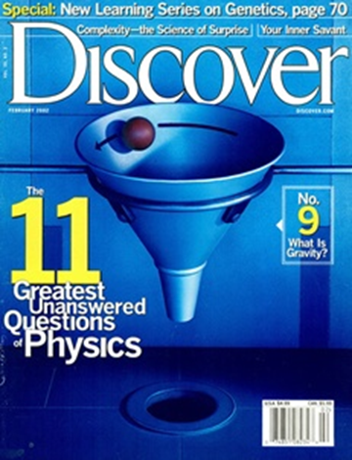
Nuclear Astrophysics
Big Bang
¹H, ²H, ³He, ⁴He, ⁶Li, ⁷Li
Cosmic Ray Spallation (interstellar medium)
Many elements, including most Li, Be, B
Stellar Burning
Up to ⁵⁶Fe
p Process (core-collapse supernovae)
Some heavy elements
rp/νp Process (x-ray bursts)
s Process (AGB stars)
Heavy elements up to A=208 (half of all heavy nuclei)
r Process (??)
Heavy elements A>56 (the other half)
Notes:
Question 3:
How were the heavy elements from iron to uranium made?

Slide 11
Neutron separation energy and mass

Slide 12
The Astrophysical R-Process
Temperatures are very high (T~10⁹K)
Neutron densities are very high (n_{n} > 10²⁰ cm⁻³)
(n,γ) rate is high ( < 1 μs/capture )
For the conditions above
…
Z
[A. Champagne, RIA Summer School ‘06]
N
10/12/2012
Notes:
As Sn drops, the number of available photons with enough energy knock out an neutron increase.
Sn comes from differentiating the Saha equation and rearranging terms
This process isn’t a single line. Many assumptions go into each model, even T and n_n have a range of possibilities

Slide 13
The Astrophysical R-Process
Temperatures are very high (T~10⁹K)
Neutron densities are very high (n_{n} > 10²⁰ cm⁻³)
(n,γ) rate is high ( < 1 μs/capture )
As region of low neutron separation energy (S_{n}) reached (n,γ) <-> (γ,n) equilibrium achieved
For the conditions above
…
Z
[A. Champagne, RIA Summer School ‘06]
N
10/12/2012
Notes:
As Sn drops, the number of available photons with enough energy knock out an neutron increase.
Sn comes from differentiating the Saha equation and rearranging terms
This process isn’t a single line. Many assumptions go into each model, even T and n_n have a range of possibilities

Slide 14
The Astrophysical R-Process
Temperatures are very high (T~10⁹K)
Neutron densities are very high (n_{n} > 10²⁰ cm⁻³)
(n,γ) rate is high ( < 1 μs/capture )
As region of low neutron separation energy (S_{n}) reached (n,γ) <-> (γ,n) equilibrium achieved
Equilibrium point defined by Saha Equation
For the conditions above
Partition Function – Ratio can vary between 10^{±4} but normally between 10^{±1}
…
Z
[A. Champagne, RIA Summer School ‘06]
N
≈ 1
10/12/2012
Notes:
As Sn drops, the number of available photons with enough energy knock out an neutron increase.
Sn comes from differentiating the Saha equation and rearranging terms
This process isn’t a single line. Many assumptions go into each model, even T and n_n have a range of possibilities

Slide 15
The Astrophysical R-Process
Temperatures are very high (T~10⁹K)
Neutron densities are very high (n_{n} > 10²⁰ cm⁻³)
(n,γ) rate is high ( < 1 μs/capture )
As region of low neutron separation energy (S_{n}) reached (n,γ) <-> (γ,n) equilibrium achieved
Equilibrium point defined by Saha Equation
For the conditions above
…
Z
[A. Champagne, RIA Summer School ‘06]
N
10/12/2012
Notes:
As Sn drops, the number of available photons with enough energy knock out an neutron increase.
Sn comes from differentiating the Saha equation and rearranging terms
This process isn’t a single line. Many assumptions go into each model, even T and n_n have a range of possibilities

Slide 16
The Astrophysical R-Process
Temperatures are very high (T~10⁹K)
Neutron densities are very high (n_{n} > 10²⁰ cm⁻³)
(n,γ) rate is high ( < 1 μs/capture )
As region of low neutron separation energy (S_{n}) reached (n,γ) <-> (γ,n) equilibrium achieved
Equilibrium point defined by Saha Equation
For the conditions above
…
Z
[A. Champagne, RIA Summer School ‘06]
N
10/12/2012
Notes:
As Sn drops, the number of available photons with enough energy knock out an neutron increase.
Sn comes from differentiating the Saha equation and rearranging terms
This process isn’t a single line. Many assumptions go into each model, even T and n_n have a range of possibilities

Slide 17
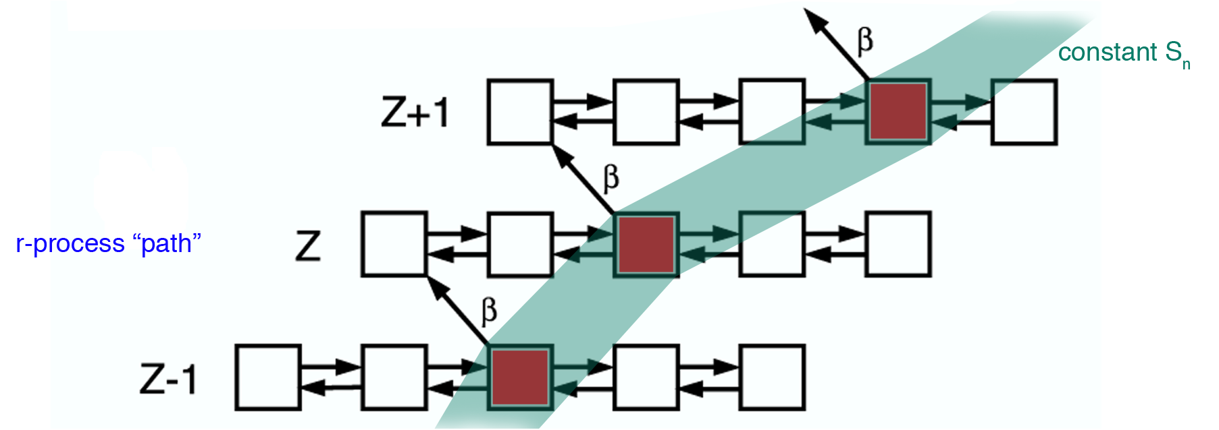
So we wait for a β-decay
[A. Champagne, RIA Summer School 06]
The S_{n} where equilibrium occurs depends only on T and n_{n}
Notes:
Walk through the process. Start with Stability and the s-process then move towards the r-process.
Note the path density at the closed shells.

Slide 18
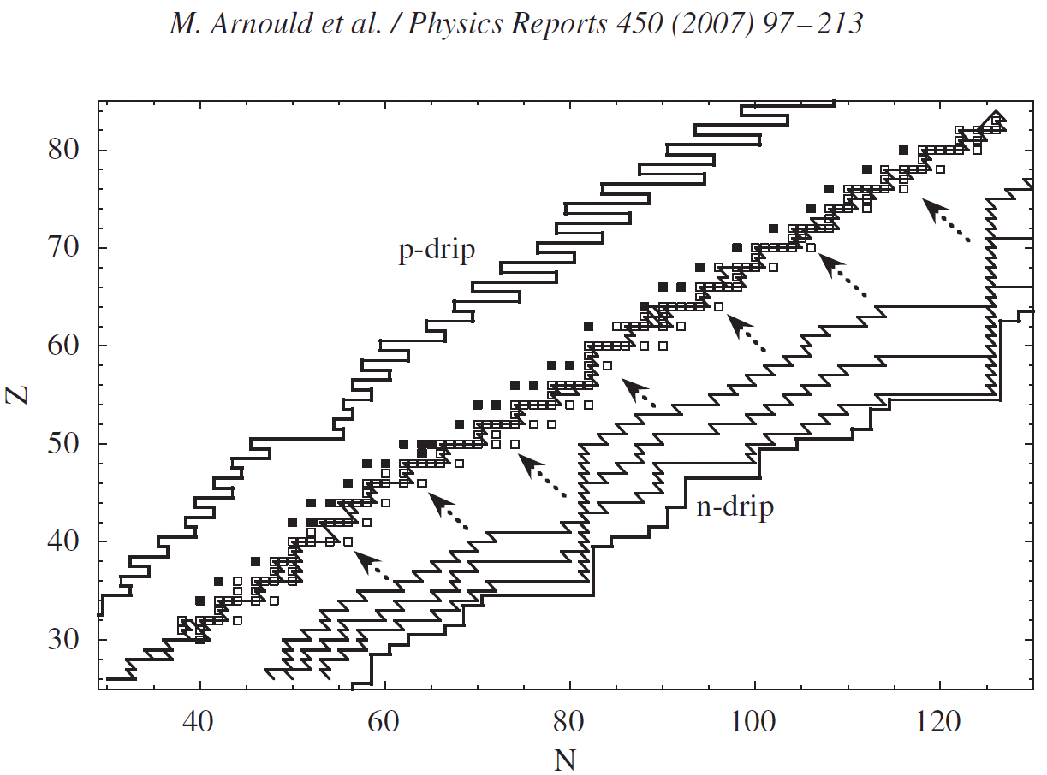
Stability
Some possible r-process paths

Slide 19
Notes:
The masses input into the model used to make this movie were entirely generated by the FRDM
Initial density of 290g/cm³, Initial T = 1.5 GK, Neutron to seed ratio of 92.

Slide 20
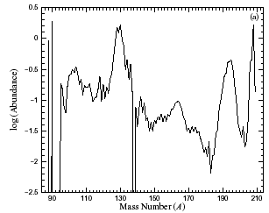
Evidence From Elemental Abundances
A | N
195 | 126
130 | 82
Y.-Z. Qian, Prog. Part. Nucl. Phys., 50 (2003) 153
Notes:
These are solar system r-process abundances
These peaks represent a clear demonstration that there is a tight correlation between solar system abundances and neutron shell closures.
The focus of this work will be on masses about the N=82 Waiting Point.

Slide 21
Neutron separation energy and mass

Slide 22
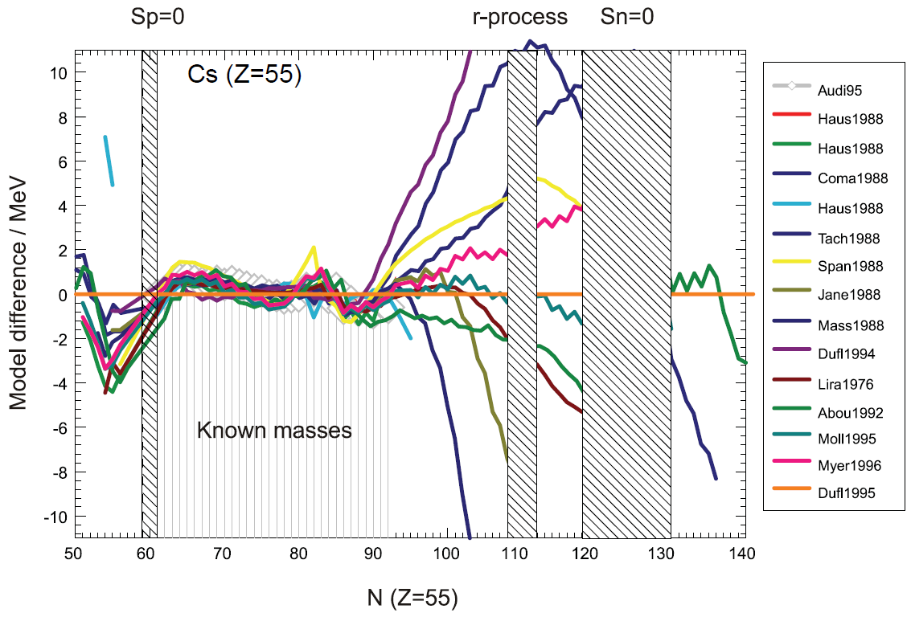
Test of nuclear mass models…(Hint: They stink!)
Notes:
Mass models suck

Slide 23
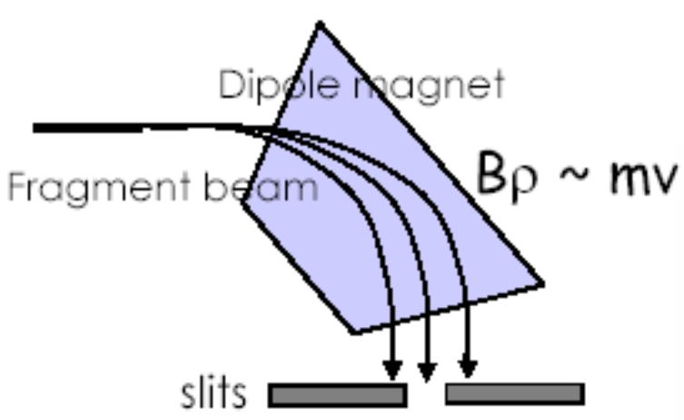
How to measure masses?
$$\vec{B}$$
Dipole mass spectrometry
$$ρ$$
$$\vec{F}$$
Charged particle in a uniform magnetic field
$\vec{F}=q\vec{v}×\vec{B}$ (Magnetic force)
$\vec{F}⊥\vec{v}$ (F is a centripetal force)
Magnetic Rigidity ($Bρ$):
Best $\frac{δm}{m}\sim {10}^{−5}$
$$\vec{F}$$
+
$$\vec{v}$$
+
$$\vec{v}$$
$$qvB=\frac{mv^{2}}{ρ}$$
Radius of curvature
$$Bρ=\frac{p}{q}$$

Slide 24
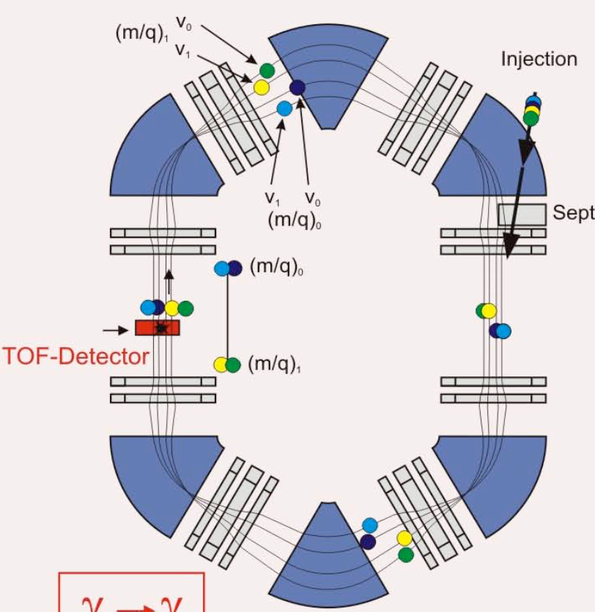
How to measure masses?
$$L$$
Time of flight mass spectrometry
Measure the time that an ion at known energy will travel a known distance.
Can be linear
Space limitation
Storage rings better
Distance unlimited
Best precision:
$$t=0$$
$$t=?$$
$$\frac{δm}{m}\sim {10}^{−6}$$

Slide 25
We can do better than ${δm}/m\sim 10^{−6}$
Actually we need
For nuclear astrophysics $\frac{δm}{m}\sim {10}^{−7}$ minimum
For fundamental symmetries: $\frac{δm}{m}\sim {10}^{−10}$ minimum
What is the physical quantity that we can measure to the highest precision?

Slide 26
Time
Time is the physical quantity we can measure most precisely
For this clock:
We can do better than $\frac{δt}{t}\sim {10}^{−15}$
When making a precision measurement, the goal is to measure time (frequency)
$$\frac{δt}{t}\sim {10}^{−14}$$
For next class:
How can you relate a time (frequency) measurement to mass?
Notes:
1 second in 3 billion years

Slide 28
Why measure masses?
 | Mass (AMU) | Δ (Mass – 180u) (AMU) | $$\frac{δm}{m}$$
¹⁸⁰Hf | 179.9466 | -0.05344 | 1.13 x 10⁻⁸
¹⁷⁹HfH | 179.9538 | -0.04624 | 1.14 x 10⁻⁸
C₆H₁₂O₆ | 180.0648 | 0.064768 | 1.00 x 10⁻¹⁰
C₉H₈O₄ | 180.0432 | 0.043178 | 1.00 x 10⁻¹⁰
C₁₀H₁₂O₃ | 180.0800 | 0.080024 | 1.00 x 10⁻¹⁰
C₇H₇F₃O₂ | 180.0406 | 0.040619 | 1.48 x 10⁻¹⁰

